Slide 1

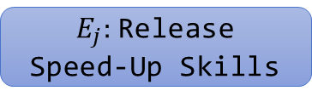



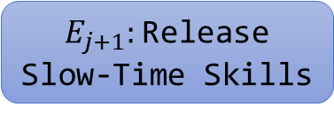



……
Actual Transition
Probable Transition
$$p$$
1
$E_{j}:$Release
Speed-Up Skills
$T_{i}:$Grab-and-Shoot-Gun
$$1−p$$
$$1−p$$
$$p$$
2
$E_{j+1}:$Release Slow-Time Skills
$T_{i+1}:$Press-Button
$$1−p$$
3
……
……

